Slide 1




Janis
A Python framework for portable pipelines
Michael Franklin
University of Melbourne / Peter MacCallum Cancer Centre
Melbourne, Australia
December, ABACBS 2019

Slide 2




Bioinformatics process
experiment
WGS
single cell
RNA Seq
proteomics
data
sequencing
images
secondary analysis
alignment
variant detection
annotation
tertiary analysis
downstream
Visualisation

Slide 3
Bioinformatics process
experiment
WGS
single cell
RNA Seq
proteomics
data
sequencing
images
secondary analysis
alignment
variant detection
annotation
tertiary analysis
downstream
Visualisation

Slide 4




Secondary analysis
scale
bigger datasets
more analysis
workflows | pipelines
multiple software
complex bioinformatics
building | executing
tied to infrastructure
local, HPC and cloud
sharing
publishing
containers
reproducibility

Slide 5
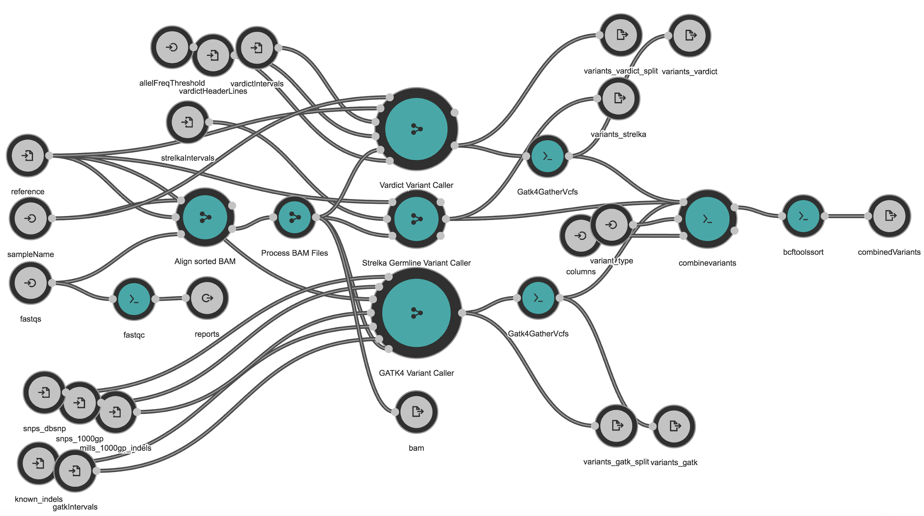
Workflows
Use to connect tasks together
dependency resolution
Benefits
restart / continue / rerun
audit trail
notifications
easy parallelism
input / output checking
Visualisation of variant-calling workflow from Rabix Composer

Slide 6



Existing specifications
Common Workflow Language (CWL)
YAML specification (key-value pairs)
hard to write, easy to parse
Workflow Description Language (WDL)
custom DSL, easier to write, hard to parse
initially by Broad Institute
Cromwell execution engine
Nextflow, Snakemake, Bpipe, ...more

Slide 7
Motivations
Portable and publishable analysis
flexible execution environment
collaboration with:
Peter Mac
Melbourne Bioinformatics at UniMelb
WEHI
Adhering to standards
follow the community
Aimed at researchers
easy to build and run pipelines
minimal configuration

Slide 8
Goals
Easy to use
Standard
Portable
Modular
Extensible
Simple API Non-technical
FAIR principles Redefine
Containers Docker Singularity
Export No lock-in
Customisable

Slide 9
Generate
protect against language deterioration
choice of execution engine
rewards of multiple technologies
CWL WDL
and
or

Slide 10

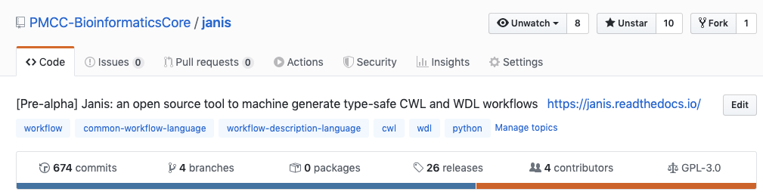
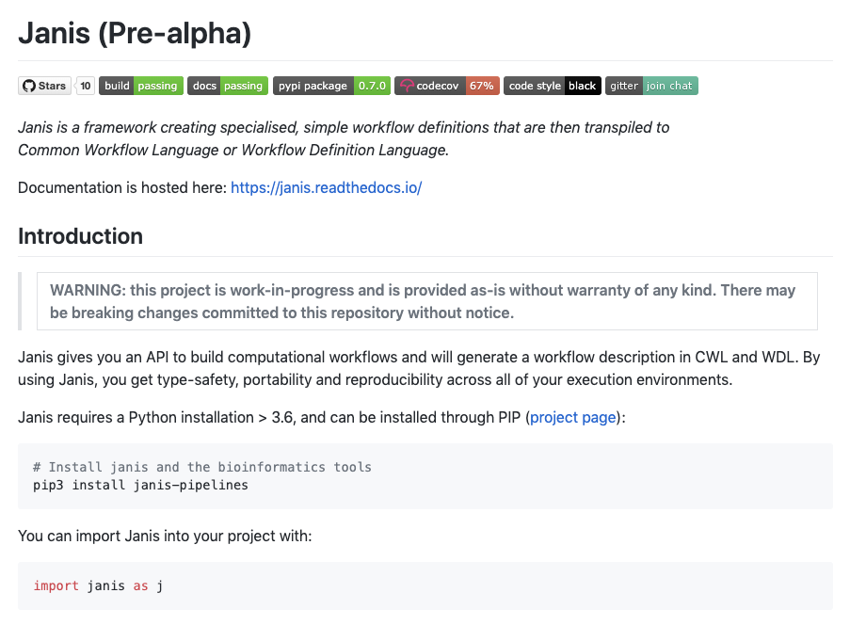
Python framework
simple API
build workflow using Janis
type-safe connections
Generates CWL and WDL
Registry of tools and types
unix
bioinformatics

Slide 11
Syntax
command tool
Declaration
import janis as j
from janis.data_types import FastaWithDict, FastqGzPair, Sam
BwaMem_0_7_15 = j.CommandToolBuilder(
Identifier
tool="bwamem",
Base command
base_command=["bwa", "mem"],
inputs=[
j.ToolInput("reference", FastaWithDict),
j.ToolInput("reads", FastqGzPair)
],
Inputs
Outputs
outputs=[j.ToolOutput("out", j.Stdout(Sam))],
container="biocontainers/bwa:v0.7.15_cv3",
version="v0.7.15"
)
Version

Slide 12
Syntax
workflow
import janis as j
from janis.data_types import FastqGzPair, FastaWithDict
from janis.tools import BwaMem_0_7_15
Imports
Declaration
wf = j.WorkflowBuilder("alignment")
Inputs
wf.input("reference", FastaWithDict)
wf.input("fastqs", FastqGzPair)
wf.step(
"bwamem",
BwaMem_0_7_15(
reads=wf.fastqs,
reference=wf.reference
)
)
Steps
Outputs
wf.output("workflow_output", source=wf.bwamem.out)

Slide 13
Functionality
Embedded subworkflows
encapsulate logic into components
Scatter and gather
by multiple fields (dot / cross)
Other features
string formatting
runtime value override (cpu / memory)

Slide 14
CWL execution
Specification
Execution engine
Compute environment
Outputs
local
.cwl
CWLTool
HPC1
Toil
outputs / logs / errors
Cromwell
HPC2
Cloud1
Cloud2
- partial support

Slide 15
WDL execution
Specification
Execution engine
Compute environment
Outputs
local
.cwl
CWLTool
HPC1
Toil
.wdl
outputs / logs /
errors
Cromwell
HPC2
Cloud1
miniWDL
Cloud2
- partial support

Slide 16
Future specifications
Specification
Execution engine
Compute environment
Outputs
local
.cwl
CWLTool
HPC1
Toil
.wdl
outputs / logs /
errors
Cromwell
HPC2
.future
Cloud1
miniWDL
?
Cloud2
future

Slide 17
Janis
Specification
Execution engine
Compute environment
Outputs
local
.cwl
CWLTool
HPC1
Janis specification
.py
Toil
.wdl
outputs / logs /
errors
Cromwell
HPC2
.future
Cloud1
miniWDL
?
Cloud2
future
- partial support

Slide 18
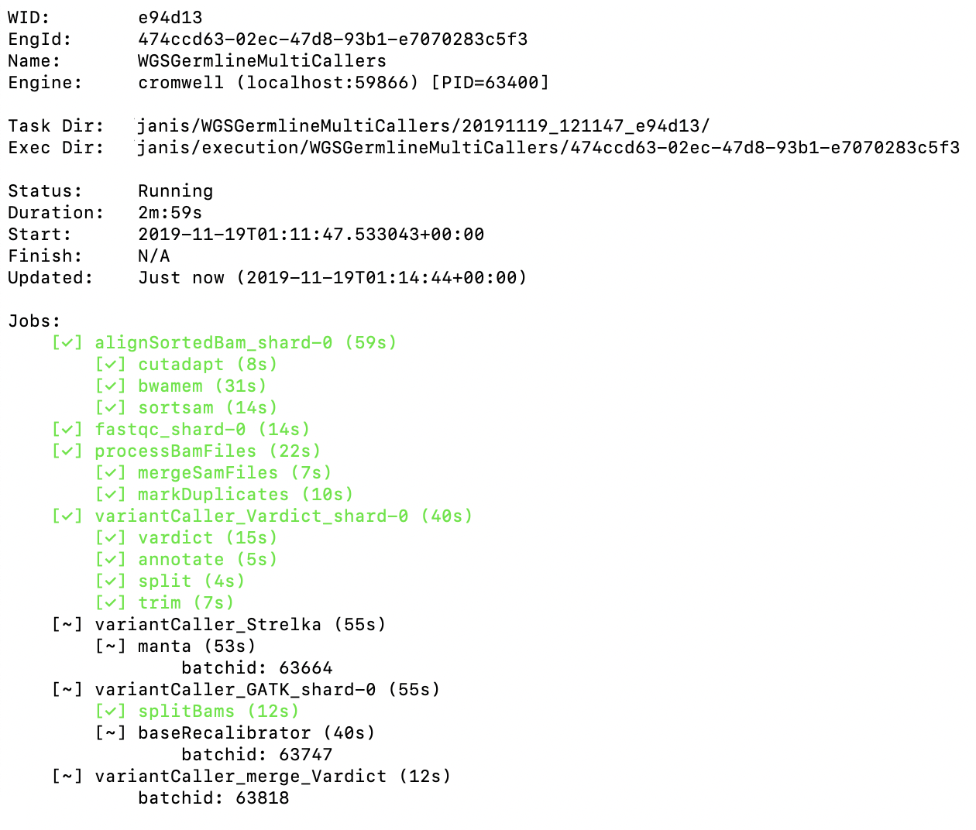
Janis assistant
Running workflows
consistency
monitor progress
collect outputs
notifications
CWLTool and Cromwell
managed by Janis
durability through MySQL
Configuration templates
slurm, PBS / torque
submit engine to cluster

Slide 19
Janis assistant
Janis specification
.py
.cwl /
.wdl /
.future
CWLTool
HPCs
outputs
Cromwell
Cloud
future
Specification
Execution engine
Compute environment
Outputs

Slide 20
Examples
Install | pip3 install janis-pipelines
Initialize | janis init slurm_singularity [--help]
Translate | janis translate fastqc wdl
Run a tool / workflow | janis run fastqc --fastq fastq1.gz
Monitor progress | janis watch $wid

Slide 21
Exemplar pipelines
WGS Germline / Somatic
GATK4, Strelka, VarDict
Demonstrates effectiveness
Visualisation of Germline workflow from Rabix Composer

Slide 22
Testing
 | Engine | Batch | Container | Runtime*
Personal | CWLTool / Cromwell | - | Docker | -
Peter Mac | Cromwell / Toil | Slurm | Singularity | 1d 13h
UniMelb | Cromwell | Slurm | Singularity | 1d 03h
WEHI | Cromwell | PBS / Torque | Singularity | 1d 07h
Pawsey | Cromwell | Slurm | Singularity | 1d 03h
Google Cloud | Cromwell | Pipelines API | Docker | 0d 23h preemtible
* dependent on resource availability

Slide 23
Private registries
Janis is extensible
Private registries
entry-points
data types and tools
execution templates
setup(
# other params
entry_points={
"janis.extension": ["bioinformatics=janis_bioinformatics"],
"janis.tools": ["bioinformatics=janis_bioinformatics.tools"],
"janis.types": ["bioinformatics=janis_bioinformatics.data_types"],
# setup.py in janis_templates
"janis.extension": ["pawsey=janis_templates"],
"janis.templates": ["pawsey=janis_templates.pawsey:PawseyTemplate"],
},
)
github: PMCC-BioinformaticsCore/janis-bioinformatics/setup.py#L27-L31

Slide 24
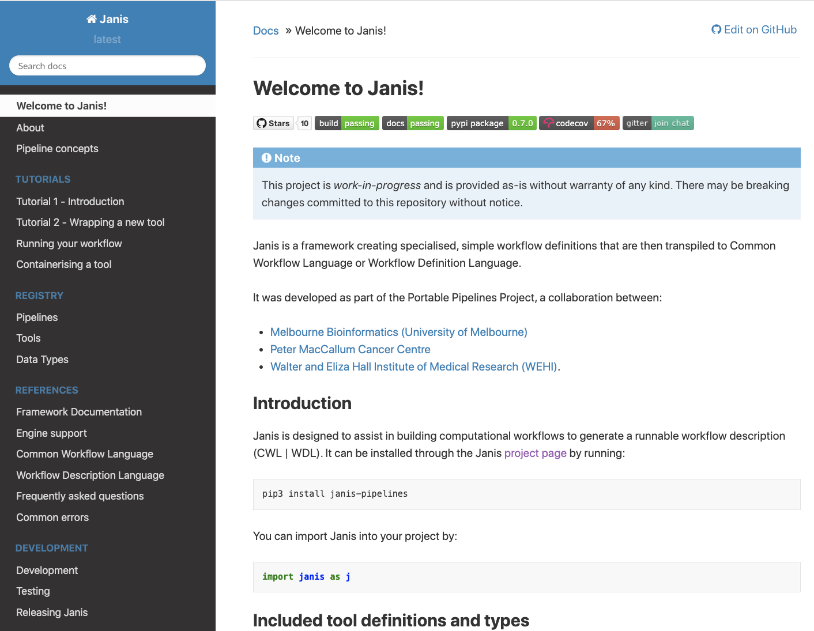
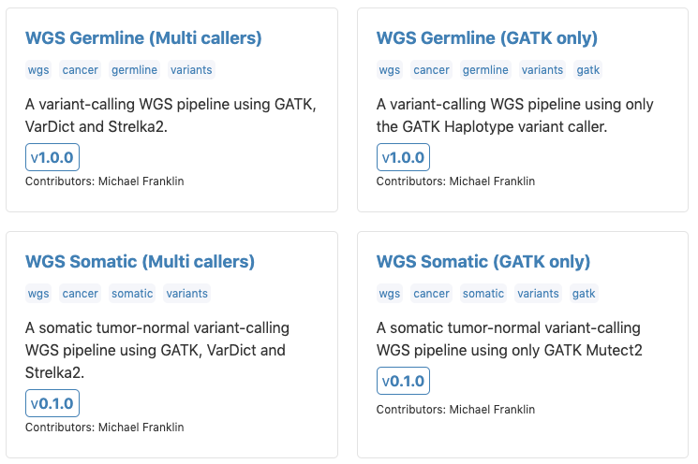




Get going!
$ pip3 install janis-pipelines
$ janis run hello # example wf
$ janis docs # opens docs
>> import janis as j
Documentation
tutorials / workshops
tools and data types
janis.readthedocs.io github.com/PMCC-BioinformaticsCore/janis gitter.im/janis-pipelines/community

Slide 25
Future Work
Expanding tool registry
Support new users
automated pipeline testing
support queues with maximum walltime
Collaborations
CWLab (DKFZ)
Notes:
Conditionals are iffy

Slide 26
Summary
Python module to build workflows
Generates CWL and WDL
Assistant to run workflows
Exemplar WGS pipelines
 | michael.franklin@petermac.org
 | janis.readthedocs.io
 | github.com/PMCC-BioinformaticsCore/janis
$ | pip3 install janis-pipelines

Slide 27
Acknowledgements
Portable Pipelines Project:
Richard Lupat (Peter Mac)
Evan Thomas (WEHI)
Daniel Park (UoM)
Bernie Pope (UoM)
Jiaan Yu (Peter Mac)
Steering Committee
Jason Li (Peter Mac)
Andrew Lonie (UoM)
Tony Papenfuss (Peter Mac / WEHI)
David Bowtell (Peter Mac)
Liz Christie (Peter Mac)
$ pip3 install janis-pipelines
$ janis run hello
Initial proof-of-concept
Mohammad Bhuyan (WEHI)
Matt Wakefield (UoM)
Peter Georgeson (UoM)
Additional
Sebastian Hollizeck (Peter Mac)

